Slide 1
Computer-Guided Fusion Probe Placement on RNA
Bioinformatics Topics
23-SEP-2020

Slide 2
RNA fusion detection in a clinical context
No database for clinically relevant RNA fusions
A few in NCI/CAP/ASH/AMP/ASCO guidelines
A few can be found in the literature
Mostly detected using FISH and Cytogenetics
No accurate breakpoint position in most cases
Many mechanisms of action
Chimeric proteins contain TK, DNA binding domains (ALK, RET, ROS)
Translocations resulting in over-expression (e.g. IGH/IGK promoters)
Promiscuous fusion partners
Heterogeneous sources of information
Fusion databases (COSMIC, ChimerDB, etc)
Competitors panels
Pharma
Literature

Slide 3
Phase 1 Solid RNA Panel
Fusions selected from COSMIC, ChimerDB, and Archer
Gene names and breakpoint positions provided verbatim to IDT for probe design
Specific probe design requested
Identify nearest exon-exon boundaries and design primers from transcript sequences

Slide 4
Phase 1 Solid RNA Panel - Results
Detailed analysis of the probe positions/coverage:
Requested probe design at the fusion junction misunderstood
Probes designed exactly at the requested positions
Many probes designed inside introns or outside transcript sequences
Probes lead to high number of WT, pre-mRNAs, and DNA reads
Not all fusions in panel successfully detected / detectable with design
Shared lack of experience with RNA probe design

Slide 5
Phase 2 Solid RNA Panel
A computer generated probe design for RNA fusions
Probe sequences directly provided to IDT
Program inputs:
Gene names
Breakpoint positions as found in databases
Program outputs:
Optimized probe positioning for detection from RNA
Corresponding probe sequences

Slide 6
Fusion Targeting: DNA vs RNA
From DNA:
Exact positions can be detected
Very high number of possibilities
No evidence of expression
Independent from gene isoforms
From RNA:
Exact positions often not known
Lower number of possibilities
Clear evidence of expression
C. Dependent on gene isoforms
BRK
BRK
E1
E2
E3
E1
E2
E3
5’ ISOF 1
5’ ISOF 1
E1
E2
E3
E1
E2
E3
5’ ISOF 2
5’ ISOF 2
E1
E2
E1
E2
5’ ISOF 3
5’ ISOF 3
TARGET REGION

Slide 7
Fusion Targeting: DNA vs RNA
From DNA:
Exact positions can be detected
Very high number of possibilities
No evidence of expression
Independent from gene isoforms
From RNA:
Exact positions often not known
Lower number of possibilities
Clear evidence of expression
Dependent on gene isoforms
BRK
BRK
E1
E2
E3
E1
E2
E3
5’ ISOF 1
5’ ISOF 1
E1
E2
E3
E1
E2
E3
5’ ISOF 2
5’ ISOF 2
E1
E2
E1
E2
5’ ISOF 3
5’ ISOF 3
TARGET REGION

Slide 8
Fusion Targeting: DNA vs RNA
From DNA:
Exact positions can be detected
Very high number of possibilities
No evidence of expression
Independent from gene isoforms
From RNA:
Exact positions often not known
Lower number of possibilities
Clear evidence of expression
Dependent on gene isoforms
BRK
BRK
E1
E2
E3
E1
E2
E3
5’ ISOF 1
5’ ISOF 1
E1
E2
E3
E1
E2
E3
5’ ISOF 2
5’ ISOF 2
E1
E2
E1
E2
5’ ISOF 3
5’ ISOF 3
TARGET REGION

Slide 9
Transcript/CDS Databases

Slide 10
Transcript/CDS Databases
Gene Representative Sequences

Slide 11
Transcript/CDS Databases
Gene Representative Sequences
Each database useful, necessary, and not sufficient
Isoform prevalence in population not available

Slide 12
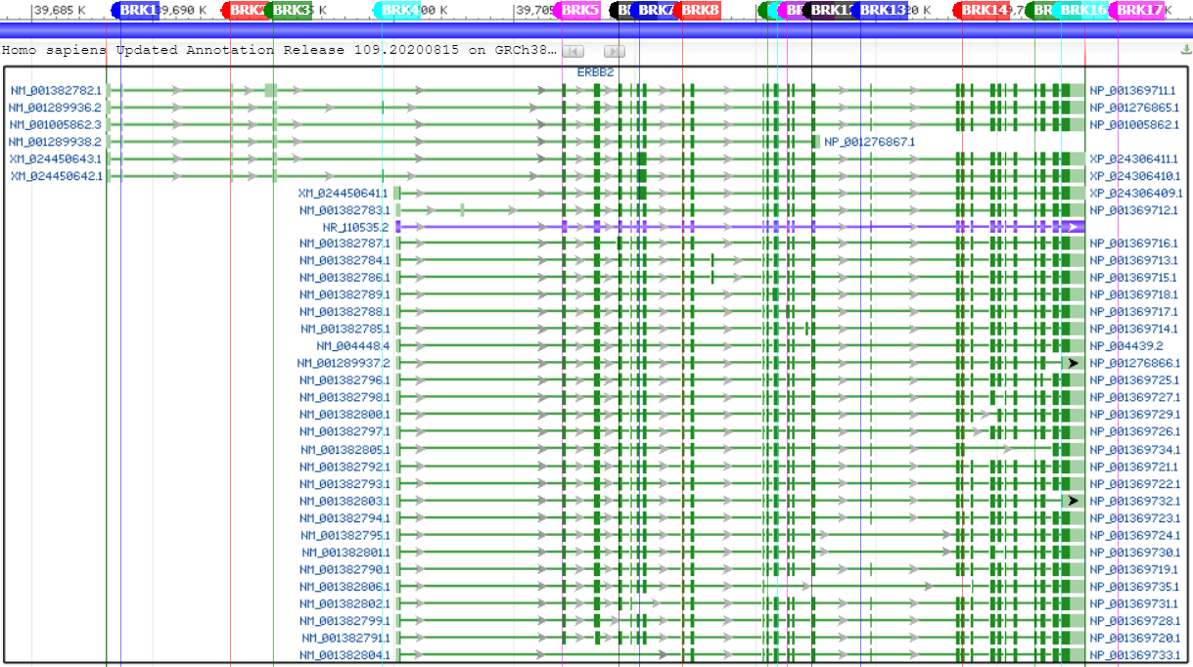
Example: 3’ gene = ERBB2 (RefSeq)

Slide 13
Example: 3’ gene = ERBB2 (RefSeq)
LRG/RefSeq
MANE

Slide 14
Example: 3’ gene = ERBB2 (RefSeq)
BRK1, BRK2, and BRK3 compatible with
3 different LRG-approved transcripts
but not with the MANE-approved one.
Which probe sequence to select when
the 3 LRG-approved transcripts have
similar but not identical sequences?
LRG/RefSeq
MANE

Slide 15
Example: 3’ gene = ERBB2 (RefSeq)
BRK4 only compatible with 1 out of
the 4 representative transcripts
LRG/RefSeq
MANE

Slide 16
Example: 3’ gene = ERBB2 (RefSeq)
BRK4 & BRK5
Two different breakpoints?
Two different observations
of the same breakpoint?
LRG/RefSeq
MANE

Slide 17
Example: 3’ gene = ERBB2 (RefSeq)
BRK13 is intronic on any isoform
3 possible probe locations
3+ possible probe sequences
Probes will span multiple exons
LRG/MANE efficient for selection
LRG/RefSeq
MANE

Slide 18
Example: 3’ gene = ERBB2 (RefSeq)
BRK17 incompatible with:
ALL RefSeq transcripts
ALL representative sequences
Explanation found in Ensembl…
LRG/RefSeq
MANE

Slide 19
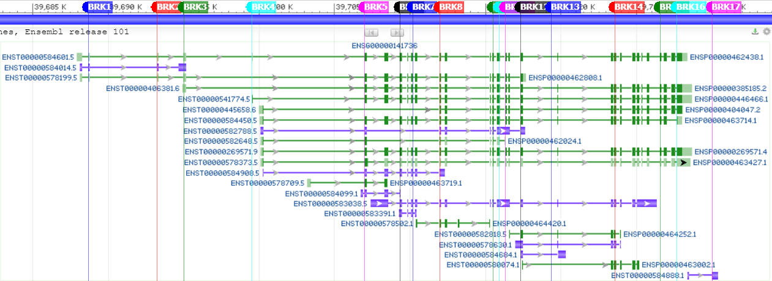
Example: 3’ gene = ERBB2 (Ensembl)
Only 1 transcript with low support
found compatible/explaining
the reported breakpoint position

Slide 20
ERBB2 example lessons
One transcript per gene does not fit all
RefSeq, Ensembl:
both useful, necessary, and not sufficient
LRG/MANE/RSG:
useful in many cases but not sufficient
does not guarantee a single best isoform/probe sequence
RefSeq, Ensembl, CCDS, LRG, MANE, RSG, HGNC, etc
each provides a small piece of “quality information”
probe placement becomes intuitive when reviewing all of it

Slide 21
Other complex situations / challenges
~150/940 genes in Platinum panel not in LRG/RSG/MANE…

Slide 22
Example: 3’ gene = ERBB2 (RefSeq)
BRK13 is intronic on any isoform
3 possible probe locations
3+ possible probe sequences
Probes will span multiple exons
LRG/MANE efficient for selection

Slide 23
Other complex situations / challenges
~150/940 genes in Platinum panel not in LRG/RSG/MANE…
Non-straightforward breakpoint locations

Slide 24
E1
E2
E3
E6
E7
E8
5’ GENE
3’ GENE
BRK
BRK
E1
E2
E3
E6
E7
E8
5’ GENE
3’ GENE
BRK
BRK

Slide 25
E1
E2
E3
E6
E7
E8
5’ GENE
3’ GENE
BRK
BRK
E1
E2
E3
E6
E7
E8
5’ GENE
3’ GENE
BRK
BRK
?
?
E2
E3
E6
E7
E8
5’ GENE
3’ GENE
BRK
BRK

Slide 26
E1
E2
E3
E6
E7
E8
5’ GENE
3’ GENE
BRK
BRK
E1
E2
E3
E6
E7
E8
5’ GENE
3’ GENE
BRK
BRK
?
?
E2
E3
E6
E7
E8
5’ GENE
3’ GENE
BRK
BRK
?
?
E1
E2
E3
E6
E8
5’ GENE
3’ GENE
BRK
BRK

Slide 27
Other complex situations / challenges
~150/940 genes in Platinum panel not in LRG/RSG/MANE…
Non-straightforward breakpoint locations
Breakpoints close to transcription start/stop positions
Transcripts shorter than IDT probe length

Slide 28
Other complex situations / challenges
~150/940 genes in Platinum panel not in LRG/RSG/MANE…
Non-straightforward breakpoint locations
Breakpoints close to transcription start/stop positions
Transcripts shorter than IDT probe length
Fast update cycles from annotation databases
Database synchronization / contradictory information

Slide 29
Other complex situations / challenges
~150/940 genes in Platinum panel not in LRG/RSG/MANE…
Non-straightforward breakpoint locations
Breakpoints close to transcription start/stop positions
Transcripts shorter than IDT probe length
Fast update cycles from annotation databases
Database synchronization / contradictory information
High number of fusions and distinct case scenarios

Slide 30
The manual approach
Gather and review information from databases
Visualize the isoforms and assess the situation
Decide probe location from this information
Not complicated, mostly requires a web browser
Time-consuming (tabs, display settings, etc)
Error-prone, not everything visible on a browser
Not an option for 3000 breakpoints…

Slide 31
The greedy approach
Automatically extract all possible combinations
Automatically remove probe redundancy
Order all resulting probe sequences
Fast, only requires RefSeq & Ensembl
Costly, high number of probes
Drowning of the fusion evidence to be expected

Slide 32
The computer-guided approach
A program mimicking the manual approach:
Collect available information from major databases:
HGNC, RefSeq, RSG, Ensembl, CCDS, UniProtKB, LRG, MANE
Extract pieces of quality information from each source
Score genes, transcripts, and fusion breakpoints
Review and score each possible combination
Place probes or discard fusion based on the scoring results
PROs
Customizable
Scalable
Reusable
Cost-efficient
CONs
Development time
Numerous cases to consider/implement
Threshold-dependent

